Slide 1

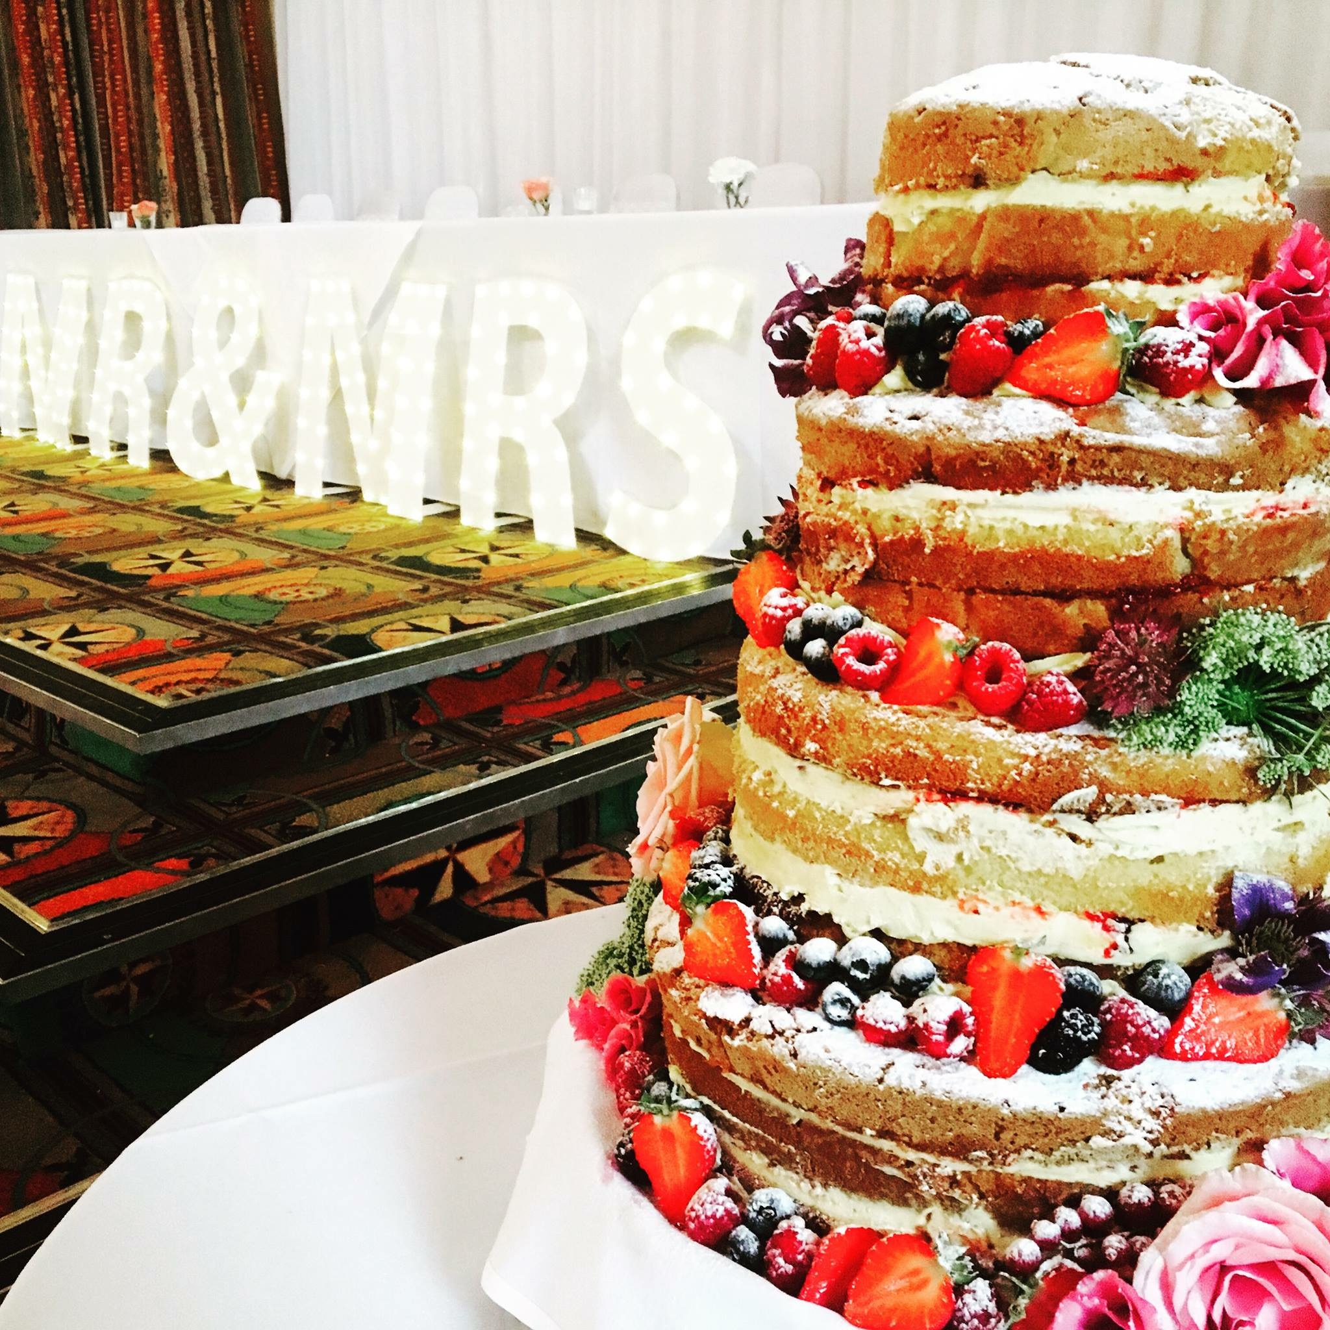
Weddings.
Introduction
Consultations
Flavours
Naked Cakes
Cupcake Tower
Dessert table
Delivery
Terms & Conditions

Slide 2
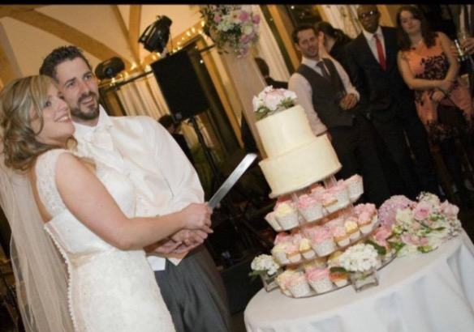
Introduction:
The wedding cake is the crowning monument of every special wedding day, and we at Airyfairy would love to be part of that special day by supplying you with one of our freshly baked soft, light and fluffy cakes. Our take on the 'Fruit Cake' is a little more modern than most. The 'Naked' or 'Fruit' cakes are extremely on trend and are proving really popular with our brides and grooms. From naked cakes to cupcakes towers to even cake buffets, we provide various options which are cost effectively for our happy couples. We welcome requests and are happy to discuss options with you, from colour scheme , to flowers, to different flavour options.

Slide 3
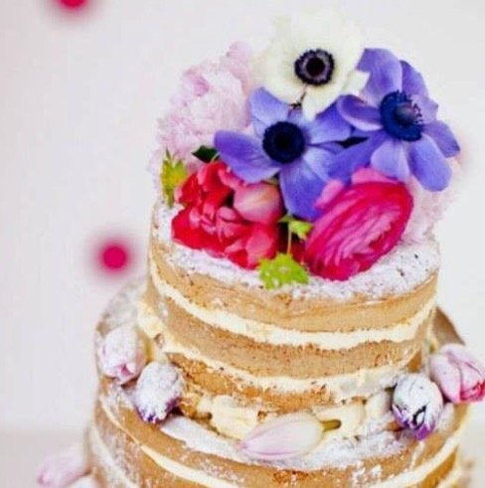
Consultations & Cake samples.
Most of our weddings bookings come through via email or over the phone this keeps the cost down for our couples as we know longer have a shop front to do one-to-one on our premises.
However we offer samples boxes with we deliver to our couples so you can try our yummy cakes and help you pick preferred flavours. These come at a charge of £10 which is refunded if booking is placed. We offer a large variety of sponge flavours as well as buttercream topping flavours. Please see page 4 for all flavours.
In addition the Airyfaries will come out to you for a one-to-one consultation if preferred. This will be approx. 30 minutes we will go through your wedding cake requirements with you step by step, offering explanations or advice where required. £10 charge is required also.
Please note that because cake samples are made especially for consultations, we cannot refund cancelled consultations if less than 4 days notice is given. However, please do call us if you need to cancel and we will make alternative arrangements wherever possible to avoid any disappointment or inconvenience.

Slide 4
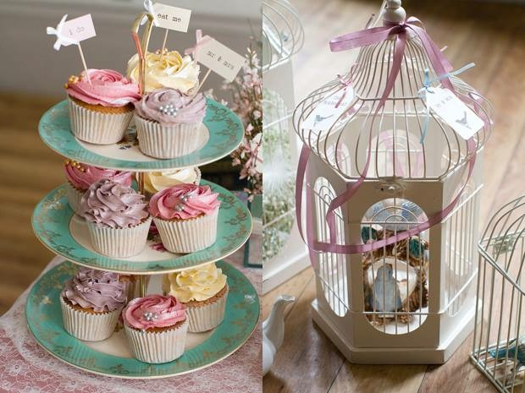
Flavours.
Vanilla – Vanilla on vanilla -always a favourite and still proving the most popular
cupcake flavour.
Chocolate - Chocolate cupcake through and through and on the top..oh and in the middle...
Raspberry – vanilla sponge with pink raspberry buttercream with or without a raspberry
jam centre.
Cookies and Cream – vanilla sponge with crushed Oreo topping
Malteser - chocolate sponge with a crushed Malteser topping
Mint - Peppermint buttercream on a chocolate sponge topped with a minty treat nom!
Lemon - Lemon or vanilla sponge and lemon flavoured topping, made with fresh juicy lemons
Chocolate Orange - Chocolate Orange flavour with a chocolate orange segment topping
Nutella - vanilla sponge with a Nutella chocolate buttercream blend topped with hazelnuts.
Carrot - We use carrot, a hint of orange & spices including nutmeg & cinnamon with
cream cheese
Apple and Cinnamon - Apple and Cinnamon with a vanilla buttercream
Apple Pie - Vanilla sponge with apple pie centre filling, vanilla buttercream and crumble topping
Peanut Butter - chocolate sponge with peanut butter cream cheese and Reese's pieces.
Coffee - coffee flavoured sponge with coffee buttercream

Slide 5
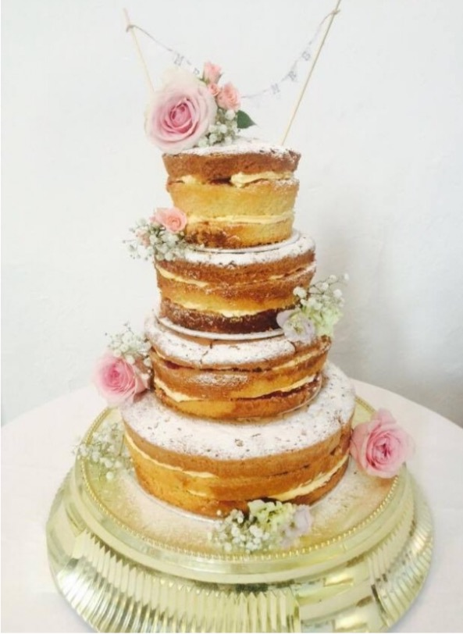
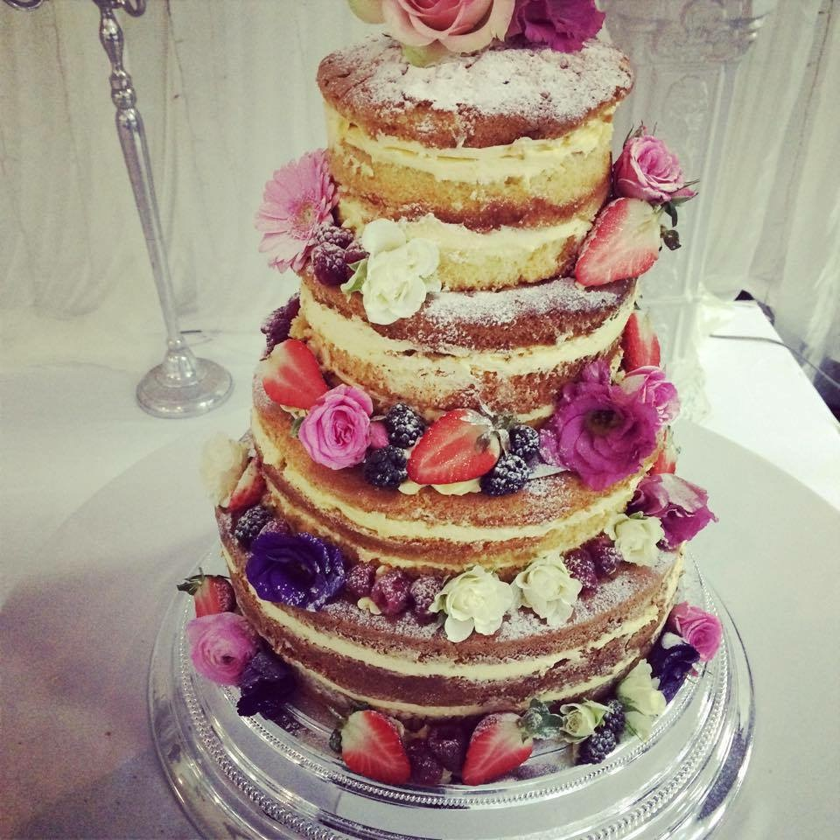
Naked Cakes.
Our take on the 'Fruit Cake' is a little more modern than most. The 'Naked' or 'Fruit' cakes are extremely on trend and are proving really popular with our lovely couples.
We can make these as a single top tier to perhaps mini naked cakes or fruit cupcakes... or go through to four tier cakes as pictured . Each of the tiers can then be made in to two or three layers.
Depending on your own tastes and colours we can do each tier as a different flavours, add seasonal fruits or link up with your florist to incorporate gorgeous blooms on to the cake.
These cakes can serve from 80 to 180 people and prices range from £130 to £350.

Slide 6
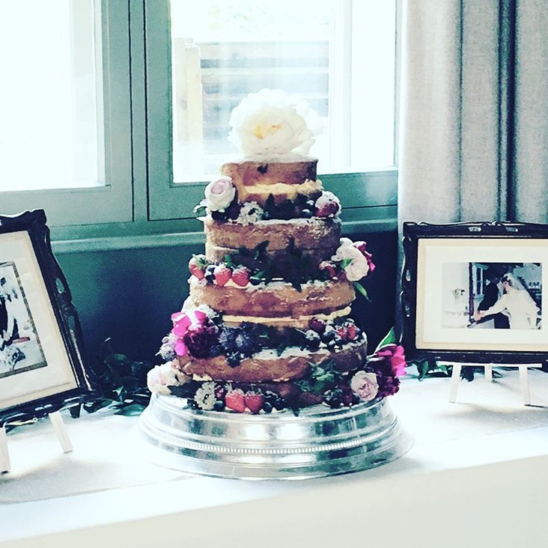
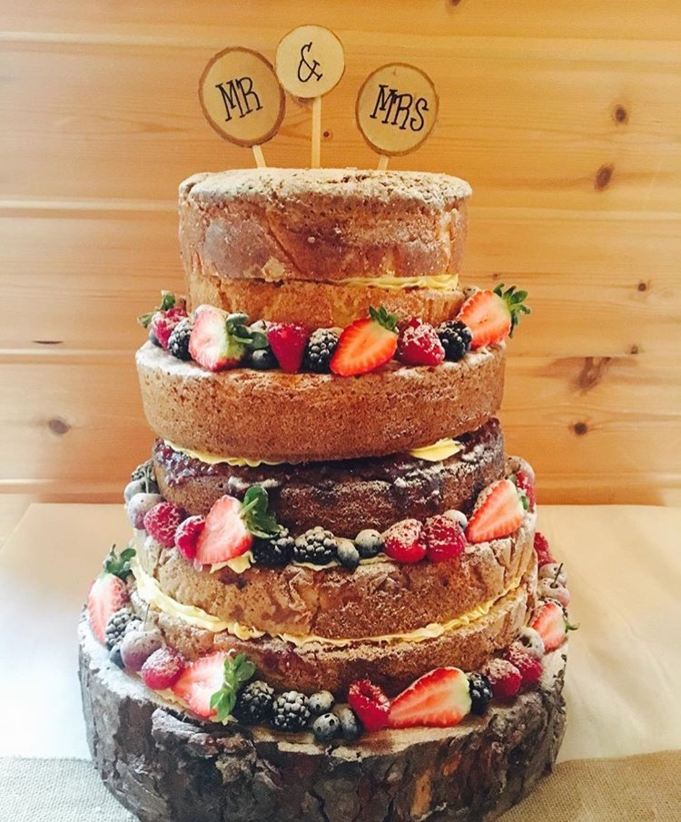
Naked cakes;
12”,10” & 8” cake serving around 100 guests start from £200.
An additional cost for flowers, cake wraps, special toppers will apply. Alternatively if the florist providing your flowers is happy enough to leave some we are more than happy to add them on while setting up.
Stand hire is £10 which requires a £50 refundable deposit once stand is returned.
We will deliver and set up your cake at the venue. Once set up a photograph will be taken as proof and then all responsibility will be passed on to the venue.

Slide 7
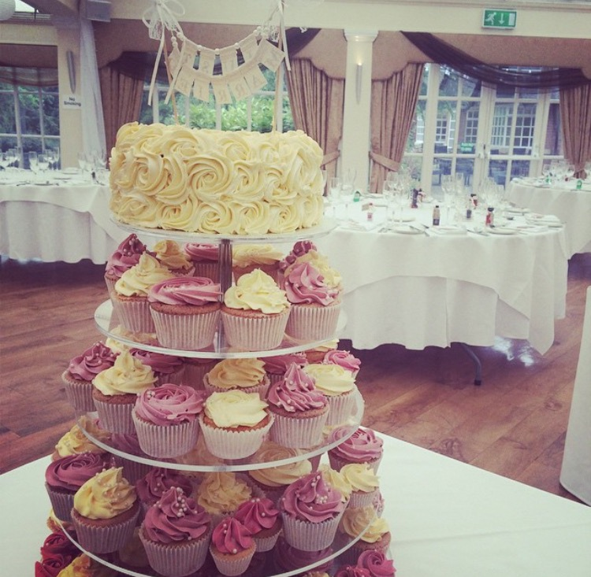
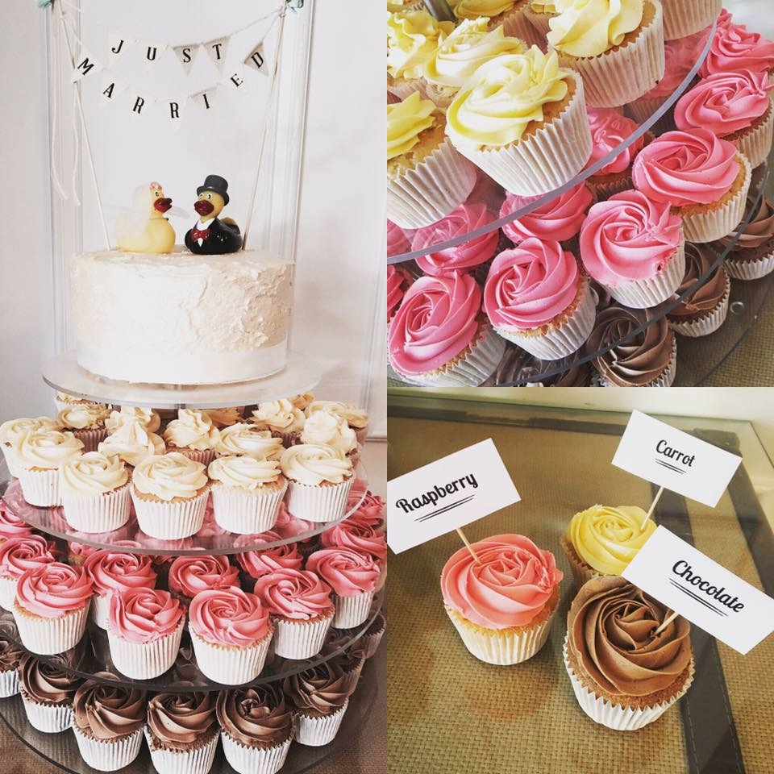
Cupcake Towers.
Our cupcake towers are still really popular choices for weddings. Cupcakes are ideal as they are already portioned up, can be easily packaged to take away with guests and can be coloured and personalised to suit your colour scheme!
Not to mention you can choose from numerous flavours as well as still have a cutting cake for the traditional bit!
The best bit is, unlike other places we don't charge a 'wedding tax' our wedding cupcakes like our other cupcakes start from £1.90, stand hire £10 and then we just add a delivery and set up charge depending on your venue location.

Slide 8
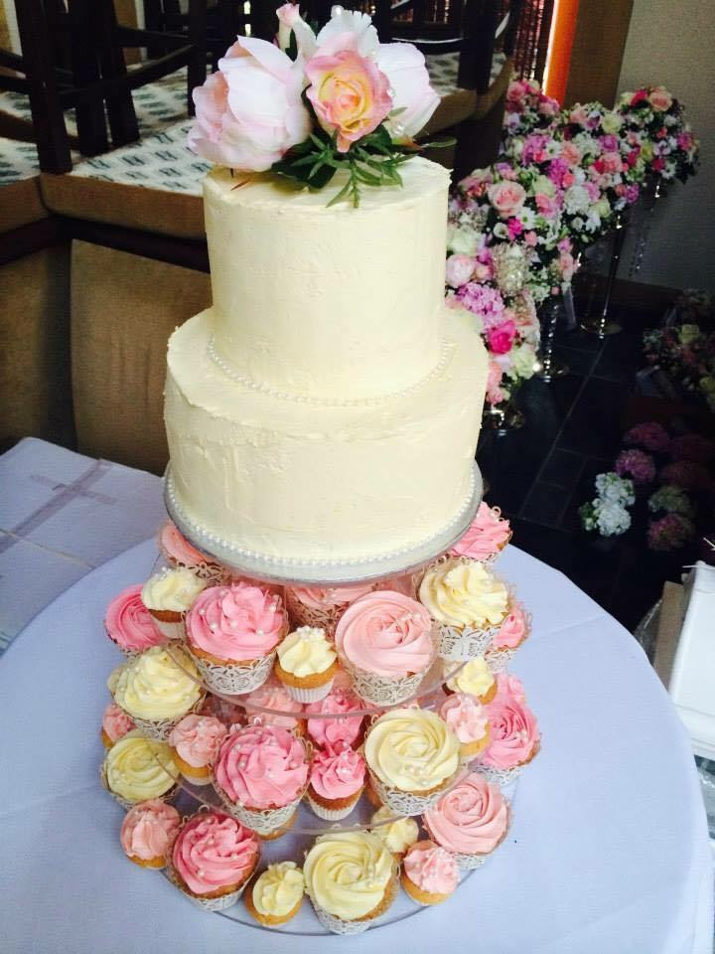
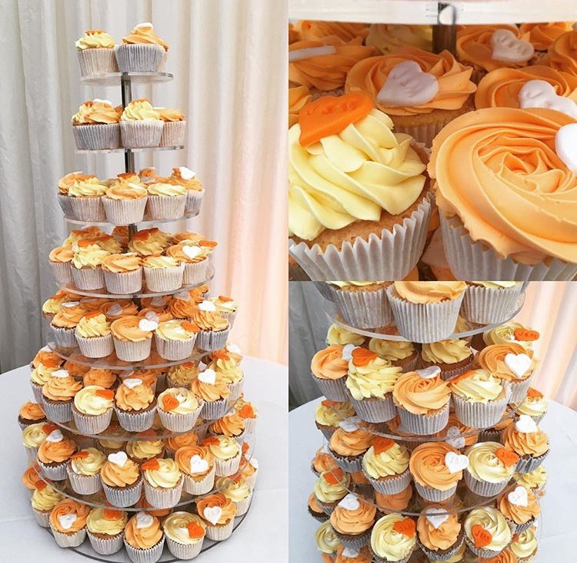
Our Cupcake towers can be topped with a cutting cake allowing you to get the traditional “cutting of cake” photograph. However our stands look beautiful with or without..
Prices;
Cutting cakes from £40 for a 6”
From £50 for 8”…
We will match our icing as close as possible to your chosen colour scheme but cannot guarantee an identical match.

Slide 9
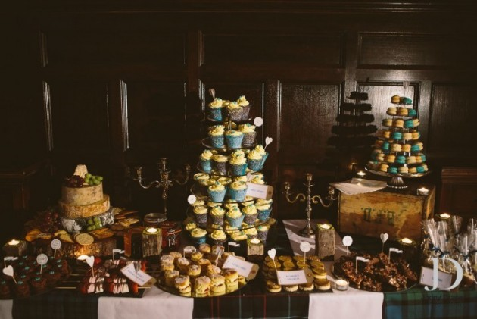
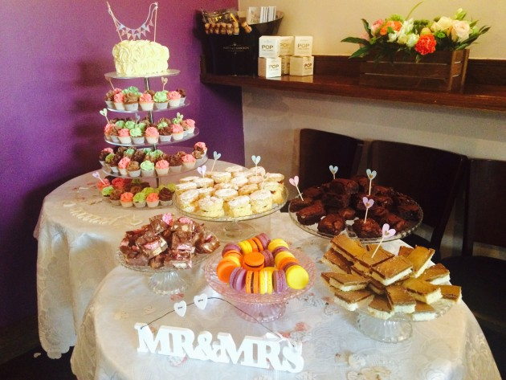
Dessert Table.
We have so many couples now realising, why have one type of cake or sweet treat when you can REALLY treat your guests and have a whole range!
This way you get a whole range of flavours, colours and suit everyone's tastes at the wedding with everything ranging from cupcakes, cake pops and macarons to flapjacks brownies and rocky road!
We can also provide you with all of the vintage or more modern cake stands and displays as well as deliver and set up the whole array so you just have to eat, drink and celebrate.
Our Cake Buffets are for a minimum of 60 people and are often a lot cheaper than people expect. We tailor prices and menus to you but start from roughly £3 - £3.50 a head.

Slide 10
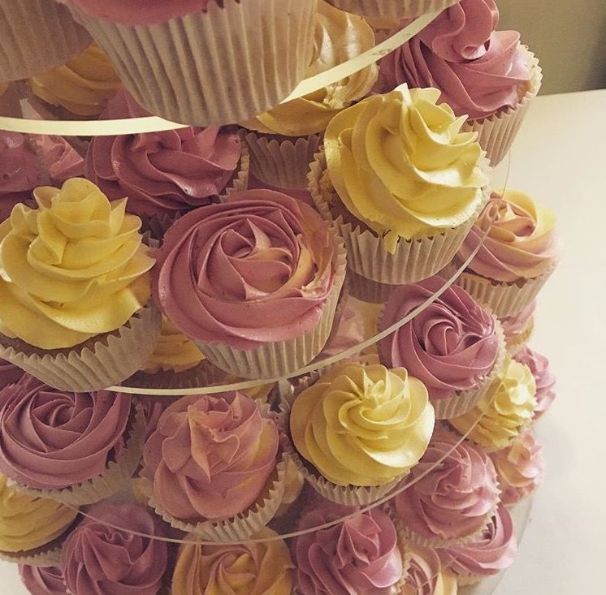
Delivery.
We will deliver and set up your wedding cake anywhere in and around the Manchester and Cheshire area. We are able to deliver to venues further afield, but this may incur a cost. Please contact us for further information.
Please note:
Do you know where your cake will be displayed? If your cake will be displayed in a marquee, the ground tends to be more uneven and unsteady. You will need to make sure that the table provided by the venue is level, sturdy and stable.
Our cakes are buttercream cakes and are therefore very delicate , once we have set them up we advise them not to be moved and positioned somewhere cool.

Slide 11
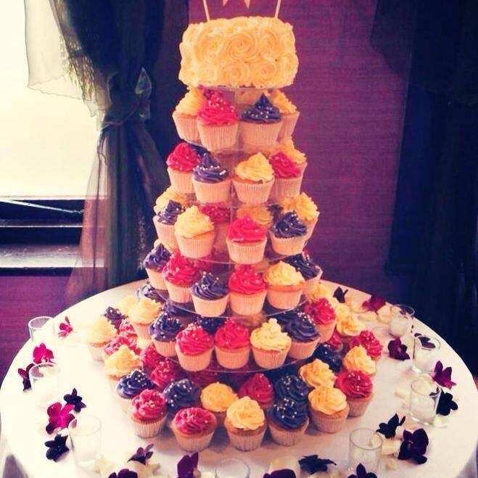
Terms & Conditions.
-Allergies & Special Dietary Requirements
All Airyfairy wedding cakes contain butter, gluten (wheat) ,sugar and eggs and are made in an environment that handles nuts & soya. Nut-free cakes can be made on request but we cannot guarantee that these cakes will not contain trace amounts due to the nature of production. Airyfairy offers the facility for gluten-free cakes but we cannot guarantee that trace amounts will not be present. Airyfairy accepts no liability for customers suffering allergic reactions from eating our cakes. It is the customer’s responsibility to make Sugarbird Cupcakes aware of any special dietary requirements that need to be accommodated in the making of their cake.
Payment & Deposits.
Customers will receive written quotes. A deposit of 50% of the total bill is required to confirm your order. Deposits are non-refundable. The final payment of the balance is due, at the latest, 30 days before the wedding. Failure to complete payment by 30 days prior to your wedding may result in your cake order being cancelled.

Slide 12
Terms & Conditions cont..
-Damages
Airyfairy Cakes accepts no liability for cakes that are damaged after they have been delivered
to the agreed location. For cakes delivered to wedding venues. Once cake has been completely set up a
phograph will be taken as proof. All Airyfairy wedding cakes are fragile and require care and attention when handling, storing and displaying to prevent damage occurring. Please take care when displaying your cake at your wedding reception to avoid direct sunlight, spotlights or candles creating damage to the cake decorations. Airyfairy cakes are designed to withstand normal and reasonable display conditions. Special requirements regarding display suitability will be discussed during the consultation process. Airyfairy accepts no liability for cakes that are damaged during display at your wedding.
-Stand hire
Our stand hire is £10 which requires a £50 deposit to cover for any damage, this will be refunded to you once the stand is either returned back to us or collected. You agree that damaged or missing pieces will be charged to you at their replacement cost, including any postage/handling charged to us by the supplier. We will charge these costs to the credit/debit card. To help prevent damage, we agree that you may return the stands to us unwashed.
Hire of cake stands is at our discretion. The stands remain our property, and you agree to return the stands to us in complete and without damage by the agreed date.
If you have any questions regarding any of our terms and conditions, please do not hesitate to contact us and we would be delighted to help. info@airyfairycakeco.com

